Slide 1

Founder - Raghavendra Katgall
HR:- Suhasini k
Teaching Staf Members
Head of Technology
Name : Anoop Desai
Name : Sakshi Yadav
DESIGNATION : WEB DEVELOPER
Name : Mansi Patil
DESIGNATION : WEB DEVELOPER
TEAM MEMBERS
Abhishek Shintre
Dinesh Jadage
Kishan Mangsule
Ishwar Gandh

Slide 2

index
1 | Title | Overview of the topic, presentation goals, and brief agenda.
2 | Introduction | Context “Hotel Management”
3 | Hardware and software | Clearly define System need be used for storage of Hotel Management.
4 | Data flow diagram | Detailed explanation of the solution(s) being proposed.
5 | Benefits & Advantages | Highlighting the positive outcomes and advantages of the solution(s).
6 | Er diagram | Steps required to implement the solution(s), Services and resources.
7 | Future scope | Real-world examples or case studies demonstrating the effectiveness.
8 | Conclusion | Summary of key points and a clear call to action for the audience. “Hotel Management”

Slide 3
INTRODUCTION
The Heart of Hospitality: Hotel management ensures exceptional guest experiences and smooth operations.
Dynamic & Evolving: The industry adapts to changing trends and technologies.
Key Focus Areas: We'll cover guest services, revenue, HR, and operations.
Opportunities & Challenges: Hotels face competition but can innovate and grow.
Goal: This presentation offers insights into effective hotel management.

Slide 4
Hardware and software requirements
Hardware:
Computers/Mobile Devices
Servers (Cloud or On-Site)
Reliable Network (Wi-Fi)
POS Terminals(Points of Sale)
Software:
PMS (Property Management)
POS (Points of Sale)
Channel & CRM (Booking & Guests)
Accounting/Housekeeping Tools

Slide 5
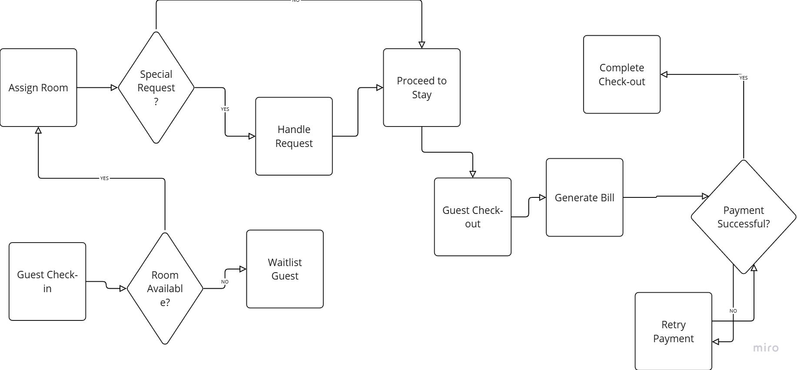
Data flow diagram of hotel management

Slide 6
Advantages and Benefits
Boosted Efficiency: Automate tasks, save time.
Enhanced Guest Experience: Personalized service, faster check-in.
Increased Revenue: Optimize bookings, manage sales.
Streamlined Operations: Centralized data, improved reporting.
Improved Online Presence: Manage bookings, enhance reputation.
Reduced Costs: Minimize errors, control inventory.

Slide 7
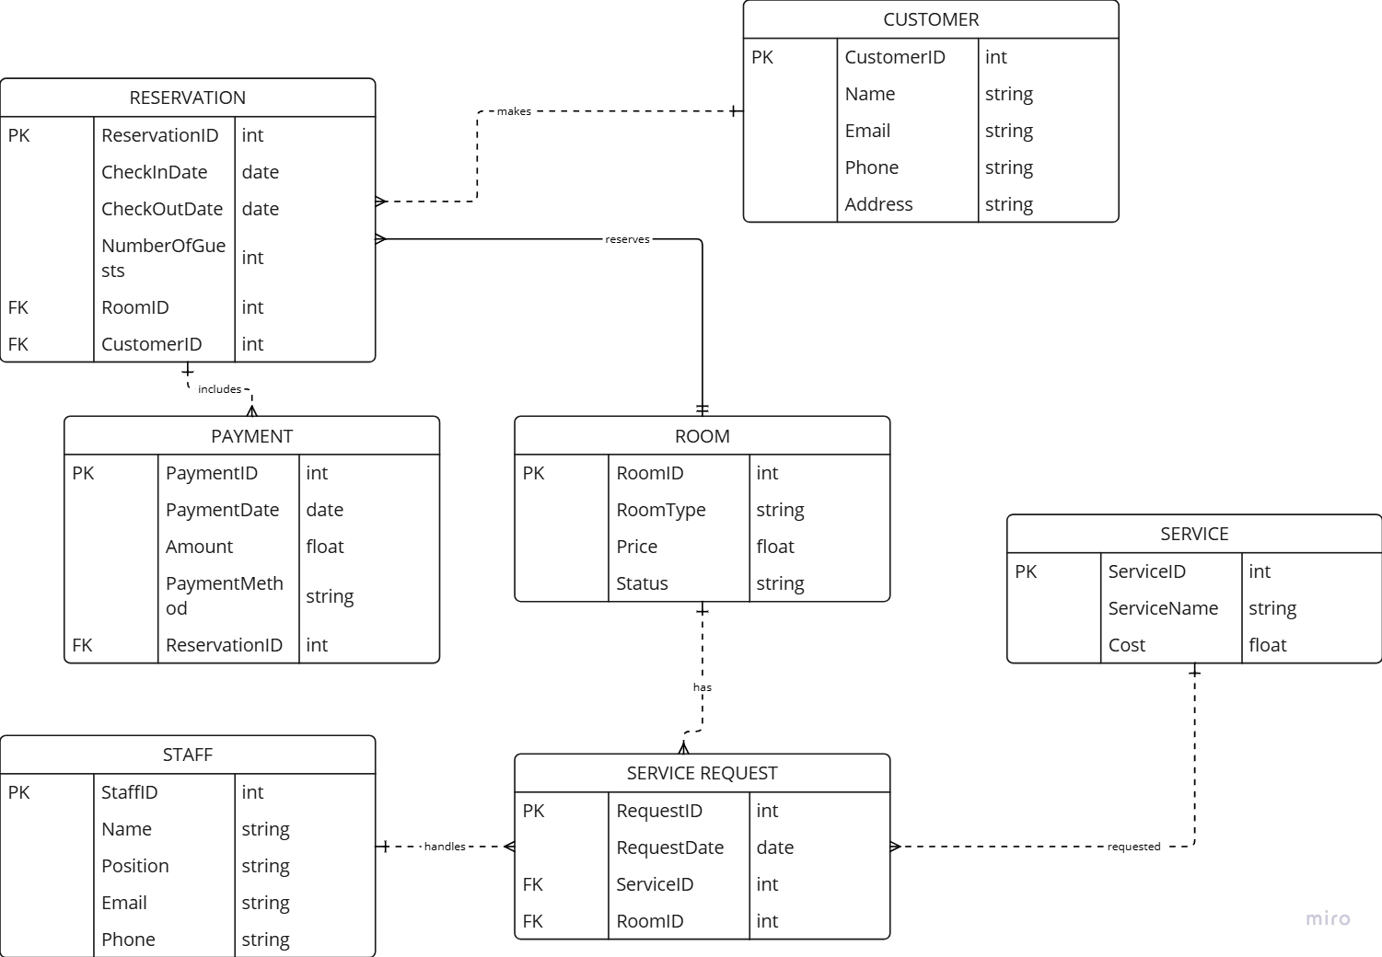
Er diagram for hotel management.

Slide 8
Future scope for hotel management
Personalized Stays: Hotels will know and cater to each guest's needs.
Eco-Friendly Focus: Friendly practices will be more important for trust.
Tech-Powered Comfort: Easier digital check-ins and room controls.
Unique Experiences: Hotels will offer more than just a place to sleep with needed stuffs.
Flexible Spaces: Rooms and lobbies will adapt to uses or Demands of Costumer.
Wellness Matters: Guests will want healthy and relaxing stays.
Smart Decisions: Hotels will use data to improve their business.

Slide 9
Conclusion
Key to Success: Effective management is essential.
Guest Focus: Prioritize exceptional experiences.
Embrace Innovation: Adapt to the evolving industry.
Drive Results: Implement smart strategies.

Slide 10


